Slide 1
Introduction
Anders Plejdrup Houmøller, Houmoller Consulting ApS
In appendix 2, you’ll find an explanation of the terminology used in this presentation.
Concerning the documents referred to in this presentation:
  You can download the documents at https://houmollerconsulting.dk/facts-findings/
This presentation is animated
  It’s recommended to run the animation when viewing the presentation.

Slide 2

The perfect storm in 2022
In 2022, Europe’s electricity markets had a period of extremely high prices – and high price volatility.
This was caused by a perfect storm:
  The sudden loss of Russian pipeline gas.
  A tight global gas market.
  Reduced nuclear and hydropower production due to outages and drought.

Slide 3



Repairing the ships – 1
After the turbulence in 2022, EU is
currently considering reforming
the electricity markets.
The market coupling is to be
improved by introducing a single Market Coupling Operator.
The accompanying enhanced regulating, cost-effectiveness and transparency is good news for the energy consumers
See the PowerPoint presentation Single Market Coupling Operator.

Slide 4
Repairing the ships – 2
It is also being considered, if consumers should be encouraged to enter into long-term contracts.
The well-intentioned plan is to reduce the consumers’ price volatility
  And to provide lower energy prices.
The spot market’s price volatility is extreme indeed
  You may refer to the PowerPoint presentations
    Hungarian spot prices 2010-2023.
    Nordic System Price 1992-2023.
Nevertheless, historically, long-term contracts have not been good for electricity consumers.

Slide 5
Long-term contracts are not good for consumers
In the Nordic countries, many years of experience show the futures market for electricity has these features:
  The futures market is not good at predicting the future spot prices.
  The futures market has a strong tendency to over-shoot
    Meaning: the estimates of the future spot prices are too high.
    Consequently, on the average, entering into futures contracts is expensive for consumers.
  The futures market’s price volatility is as extreme as the spot market’s price volatility
    If you enter into a futures contract: the price of the contract will vary greatly, depending on when you enter into the contract!
      Hence, long-term contracts offer no escape from the electricity market’s price volatility.
The year 2022 shows these features are magnified during periods of turbulence.
Please see appendix 1.

Slide 6
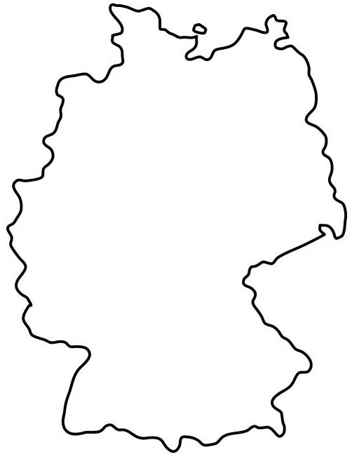
Appendix 1
German forward prices for electricity

Slide 7
Estimating the future prices for electricity
This appendix presents the market’s estimates of the future whole-sale prices for electricity
  The so-called spot prices.
This appendix discusses the German prices.
The German prices constitute a benchmark for Continental Europe because:
  Germany is Europe’s biggest and most liquid electricity market.
  Germany has a central position with electrical connections to 11 other countries.

Slide 8
German forward prices for electricity – 1
At the next slide, the green curve shows the market’s estimates of the average German spot price for the first quarter of 2023 (Q1-2023)
  The green curve shows the estimates made from 7 October 2022 to the end of December 2022.
This slide – and the following, similar slides – illustrates the features of the futures market listed at slide no. 5.

Slide 9
German forward prices for electricity – 2
For the first quarter of 2023
€/MWh
480
The market’s estimate of the average
German spot price for Q1-2023
440
400
360
320
280
240
200
160
120
80
Average German spot price Q1-2023: 115.8 €/MWh
40
0
October 2022
November 2022
December 2022
Sources: EEX and Nord Pool
Trading days 2022

Slide 10
German forward prices for electricity – 3
At the next slide, the green curve shows the market’s estimates of the average German spot price for the second quarter of 2023 (Q2-2023)
  The green curve shows the estimates made from 7 October 2022 to the end of March 2023.

Slide 11
German forward prices for electricity – 4
For the second quarter of 2023
€/MWh
360
The market’s estimate of the average
German spot price for Q2-2023
320
280
240
200
160
120
80
Average German spot price Q2-2023: 92.3 €/MWh
40
0
Oct 22
Nov 22
Dec 22
Jan 23
Feb 23
Mar 23
Trading days 2022-2023
Sources: EEX and Nord Pool

Slide 12

German forward prices for electricity – 5
At the next slide, the green curve shows the market’s estimates of the average German spot price for the year 2023
  The green curve shows the estimates made from 24 October 2022 to the end of December 2022.

Slide 13
German forward prices for the year 2023
€/MWh
400
360
320
280
The market’s estimate of the average
German spot price for 2023
240
200
160
120
80
Average German spot price 2023: 95.2 €/MWh
40
0
November 2022
December 2022
Sources: EEX and Nord Pool
Trading days 2022

Slide 14

German forward prices for electricity for the years 2024 and 2025
The two following slides further illustrate the futures market’s price volatility.
For each slide, the green curve shows the market’s estimates of the average German spot price for the year 2024 and 2025, respectively
  The green curve shows the estimates made from 24 October 2022 to 14 July 2023.
The lesson: if you enter into a fix-price contract for one of the years 2024 or 2025
  Then the contract’s fixed price will vary wildly
    Dependent upon when you enter into the contract.

Slide 15
German forward prices for the year 2024
€/MWh
300
280
The market’s estimate of the average
German spot price for 2024
260
240
220
200
180
160
140
120
100
80
60
40
20
0
Nov
Dec
Jan
Feb
Mar
Apr
May
Jun
Trading days 2022-2023
Source: EEX

Slide 16
German forward prices for the year 2025
€/MWh
200
The market’s estimate of the average
German spot price for 2025
180
160
140
120
100
80
60
40
20
0
Nov
Dec
Jan
Feb
Mar
Apr
May
Jun
Trading days 2022-2023
Source: EEX

Slide 17

More information
For more information, see the PowerPoint presentations
  Financial prices and spot prices – annual contracts 2002-2017.
  Financial prices and spot prices – quarter contracts 2006-2017.
These presentations give you the experiences from the Nordic market for power derivatives.

Slide 18
Appendix 2
Terminology
Forward price The price of a futures contract. See Wikipedia futures contract.
Futures market See Wikipedia futures contract.
Market coupling See the PDF document The Liberalized Electricity Market and the PowerPoint presentation Unbundling and EU’s Single Electricity Market.
Power derivative See the PDF document The Liberalized Electricity Market.
Spot price See the PowerPoint presentation Maximizing the economic value of market coupling and spot trading.
You may also refer to the PDF document The Liberalized Electricity Market.

Slide 19

Thank you for your attention!
Anders Plejdrup Houmøller
Houmoller Consulting
Tel. +45 28 11 23 00
anders@houmollerconsulting.dk
www.houmollerconsulting.dk

